Slide 1


CMR TECHNICAL CAMPUS UGC (Autonomous) Kandlakoya, Medchal Road, Hyd-501 401 Department of Computer Science and Engineering
Mini Project Review
PLANT LEAF DISEASE PREDICTION USING DEEP LEARNING
BATCH NO-14
Project Guide:
Mr M. Madhusudhan
Assistant Professor, CSE Department
Project Coordinator:
Mr Dr J. Narasimha Rao
Associate Professor, CSE Department
Presented by:
217R1A05R7 : V. Sindhu Bhargavi
227R5A0525 : S. Sruthi

Slide 2
ABSTRACT
Plant leaf disease prediction is a crucial aspect of agricultural management. Agriculture is the most important sector of our Economy. Proper management leads to a profit in agricultural products. Farmers do not expertise in leaf disease so they produce less production.
Main aim of our project is to detect the apple, grape, corn, potato and tomato plants leaf diseases. Plant leaf diseases are monitoring of large fields of crops disease detection, and thus automatically detected the some feature of diseases as per that provide medical treatment.
Proposed CNN model has been compared with popular transfer learning approach such as VGG16.
Plant leaf disease detection has wide range of applications available in various fields such as Biological Research and in Agriculture Institute.

Slide 3
EXISTING SYSTEM
The current landscape of plant leaf disease prediction predominantly relies on manual visual inspection by agricultural experts, which is time-consuming, labor-intensive, and prone to human error. Traditional methods involve examining leaves for symptoms like discoloration and lesions, making early detection challenging, especially in large fields.
These systems often rely on simple algorithms that may not effectively handle varying environmental conditions or diverse disease manifestations.
Possible solutions to these problems include early disease detection, crop monitoring, and individualized therapies. In most cases, experts in agriculture can identify a disease only by observing its symptoms. However, farmers have a hard time getting in touch with professionals.

Slide 4
DISADVANTAGES OF EXISTING SYSTEM
Time-Consuming
Human Error
Limited Early Detection
Basic Algorithms
Scalability Concerns
Computational Costs

Slide 5
PROPOSED SYSTEM
Our project is designed to automate plant leaf disease prediction, facilitating early and accurate diagnoses to support timely agricultural interventions.
Central to our approach is the use of convolutional neural networks (CNNs), which excel in image recognition tasks. CNNs can automatically learn and extract relevant features from raw leaf images, making them ideal for identifying disease symptoms.
Our project includes a comprehensive database of labeled plant leaf images that covers various disease types and severity levels, providing a solid foundation for model training and evaluation.
We created it as a web app ,this web-based service allows users to train a CNN model, which then uses the user-uploaded images to forecast the onset of disease, CNN can identify which plant illnesses exist in the photos.

Slide 6
ADVANTAGES OF PROPOSED SYSTEM
Early Detection
High Accuracy
Comprehensive Database
User-Friendly Interface
Scalability
Cost-Effective Solutions
Real-Time Monitoring

Slide 7
HARDWARE REQUIREMENTS
Processor : i5 or Above
Hard Disk : 40 GB
RAM : 8 GB
SOFTWARE REQUIREMENTS
Operating System : Windows 8 or Above
Programming Language : python 3.7.0

Slide 8
NOVELTY OF PROJECT
Our project Plant Leaf Disease Prediction Using lies in its innovative approach of deep Convolutional Neural Networks (CNNs), specifically for real-time plant leaf disease classification.
Our project introduces a unique social collaborative platform where users can upload images of diseased plants, which are automatically added to a cloud-based dataset for continuous retraining of the model.
The web-based app enables farmers to access real-time disease predictions in the field, making advanced technology more accessible
Additionally, the scalable and low-cost nature of the solution ensures that it can be widely deployed, making it a practical and evolving tool for plant disease management.

Slide 9
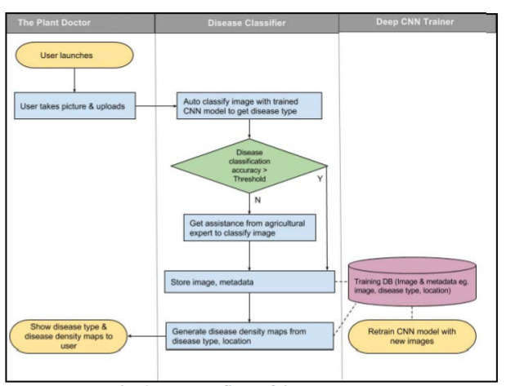
ARCHITECTURE

Slide 10
MODULES
Register:
Create a new user account to access the plant disease prediction platform.
Login:
Sign in to the platform using your registered credentials.
Upload plant image:
Submit a plant leaf image for disease prediction and analysis.
Logout:
Exit your account and end the current session on the platform.

Slide 11
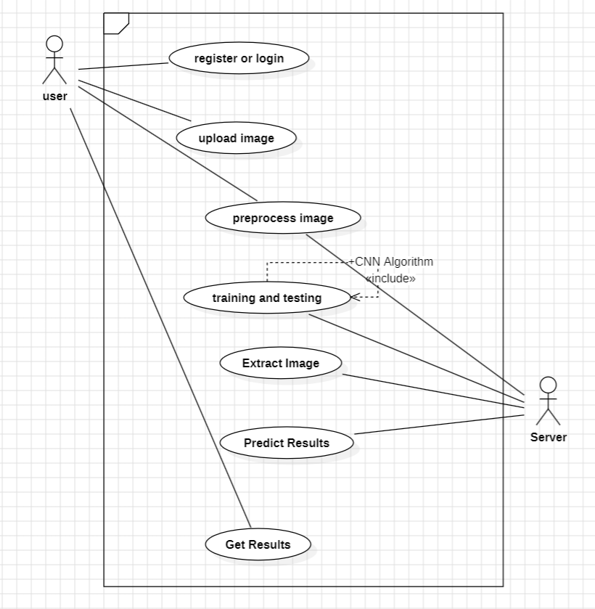
USE CASE DIAGRAM

Slide 12
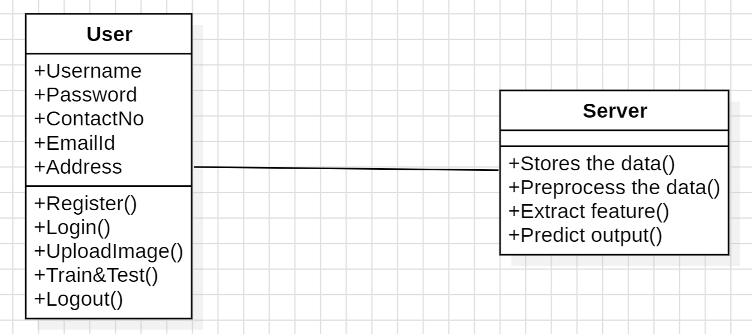
CLASS DIAGRAM

Slide 13
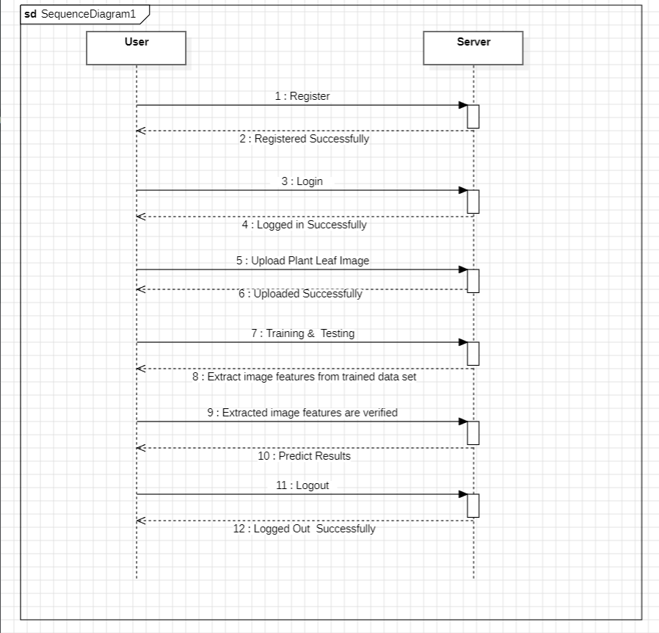
SEQUENCE DIAGRAM
x
x

Slide 14
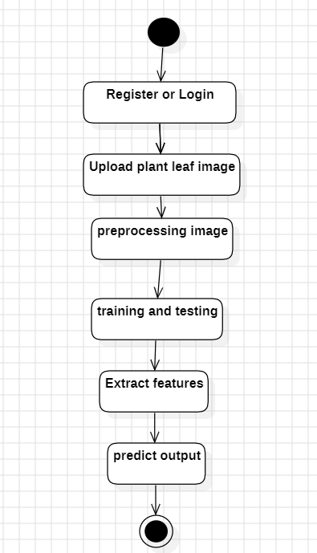
ACTIVITY DIAGRAM

Slide 15
SAMPLE CODE
import numpy as np
import os from keras.models
import model_from_json from keras.utils.np_utils
import to_categorical
import cv2 from sklearn.model_selection
import train_test_split from keras.layers
import Input from keras.models
import Model from keras.layers
import Conv2D, MaxPooling2D from keras.layers
import Dense, Dropout, Activation, Flatten from keras.layers
import Convolution2D from keras.models
import Sequential import keras plants = ['Pepper__bell___Bacterial_spot', 'Pepper__bell___healthy', 'Potato___Early_blight', 'Potato___healthy', 'Potato___Late_blight', 'Tomato_Bacterial_spot', 'Tomato_Early_blight', 'Tomato_healthy', 'Tomato_Late_blight', 'Tomato_Leaf_Mold', 'Tomato_Septoria_leaf_spot’, 'Tomato_Spider_mites_Two_spotted_spider_mite', 'Tomato__Target_Spot', 'Tomato__Tomato_mosaic_virus', 'Tomato__Tomato_YellowLeaf__Curl_Virus']

Slide 16
X = []
Y = []
'‘’
for i in range(len(plants)):
for root, dirs, directory in os.walk('PlantVillage/'+plants[i]):
for j in range(len(directory)):
img = cv2.imread('PlantVillage/'+plants[i]+"/"+directory[j])
img = cv2.resize(img, (64,64)) im2arr = np.array(img)
im2arr = im2arr.reshape(64,64,3)
X.append(im2arr)
Y.append(i)
print('PlantVillage/'+plants[i]+"/"+directory[j]) np.save("model/myimg_data.txt",X) np.save("model/myimg_label.txt",Y)
X = np.load("model/myimg_data.txt.npy")
Y = np.load("model/myimg_label.txt.npy")
X = np.asarray(X)
Y = np.asarray(Y)
print(X.shape)
Y = to_categorical(Y)
print(Y.shape)
img = X[20].reshape(64,64,3)

Slide 17
cv2.waitKey(0)
print("shape == "+str(X.shape))
print("shape == "+str(Y.shape))
print(Y)
X = X.astype('float32’)
X = X/255
indices = np.arange(X.shape[0])
np.random.shuffle(indices)
X = X[indices]
Y = Y[indices]
classifier = Sequential() #alexnet transfer learning code here classifier.add(Convolution2D(32, 3, 3, input_shape = (64, 64, 3), activation = 'relu’))
classifier.add(MaxPooling2D(pool_size = (2, 2))) classifier.add(Convolution2D(32, 3, 3, activation = 'relu')) classifier.add(MaxPooling2D(pool_size = (2, 2))) classifier.add(Flatten())
classifier.add(Dense(output_dim = 128, activation = 'relu')) classifier.add(Dense(output_dim = 15, activation = 'softmax')) classifier.compile(optimizer = 'adam', loss = 'categorical_crossentropy', metrics = ['accuracy']) print(classifier.summary())

Slide 18
classifier.fit(X, Y, batch_size=16, epochs=10, validation_split=0.2, shuffle=True, verbose=2) classifier.save_weights('model/model_weights.h5') model_json = classifier.to_json() with open("model/model.json", "w") as json_file: json_file.write(model_json) ''' with open('model/model.json', "r") as json_file:
loaded_model_json = json_file.read()
loaded_model = model_from_json(loaded_model_json) loaded_model.load_weights("model/model_weights.h5") loaded_model._make_predict_function() print(loaded_model.summary())
img = cv2.imread('download.jpg’)
img = cv2.resize(img, (64,64))
im2arr = np.array(img)
im2arr = im2arr.reshape(1,64,64,3)
X = np.asarray(im2arr)
X = X.astype('float32’)
X = X/255 preds = loaded_model.predict(X)
print(str(preds)+" "+str(np.argmax(preds)))
predict = np.argmax(preds)
print(plants[predict])
img = im2arr.reshape(64,64,3) cv2.imshow(plants[predict],cv2.resize(img,(250,250))) cv2.waitKey(0)

Slide 19
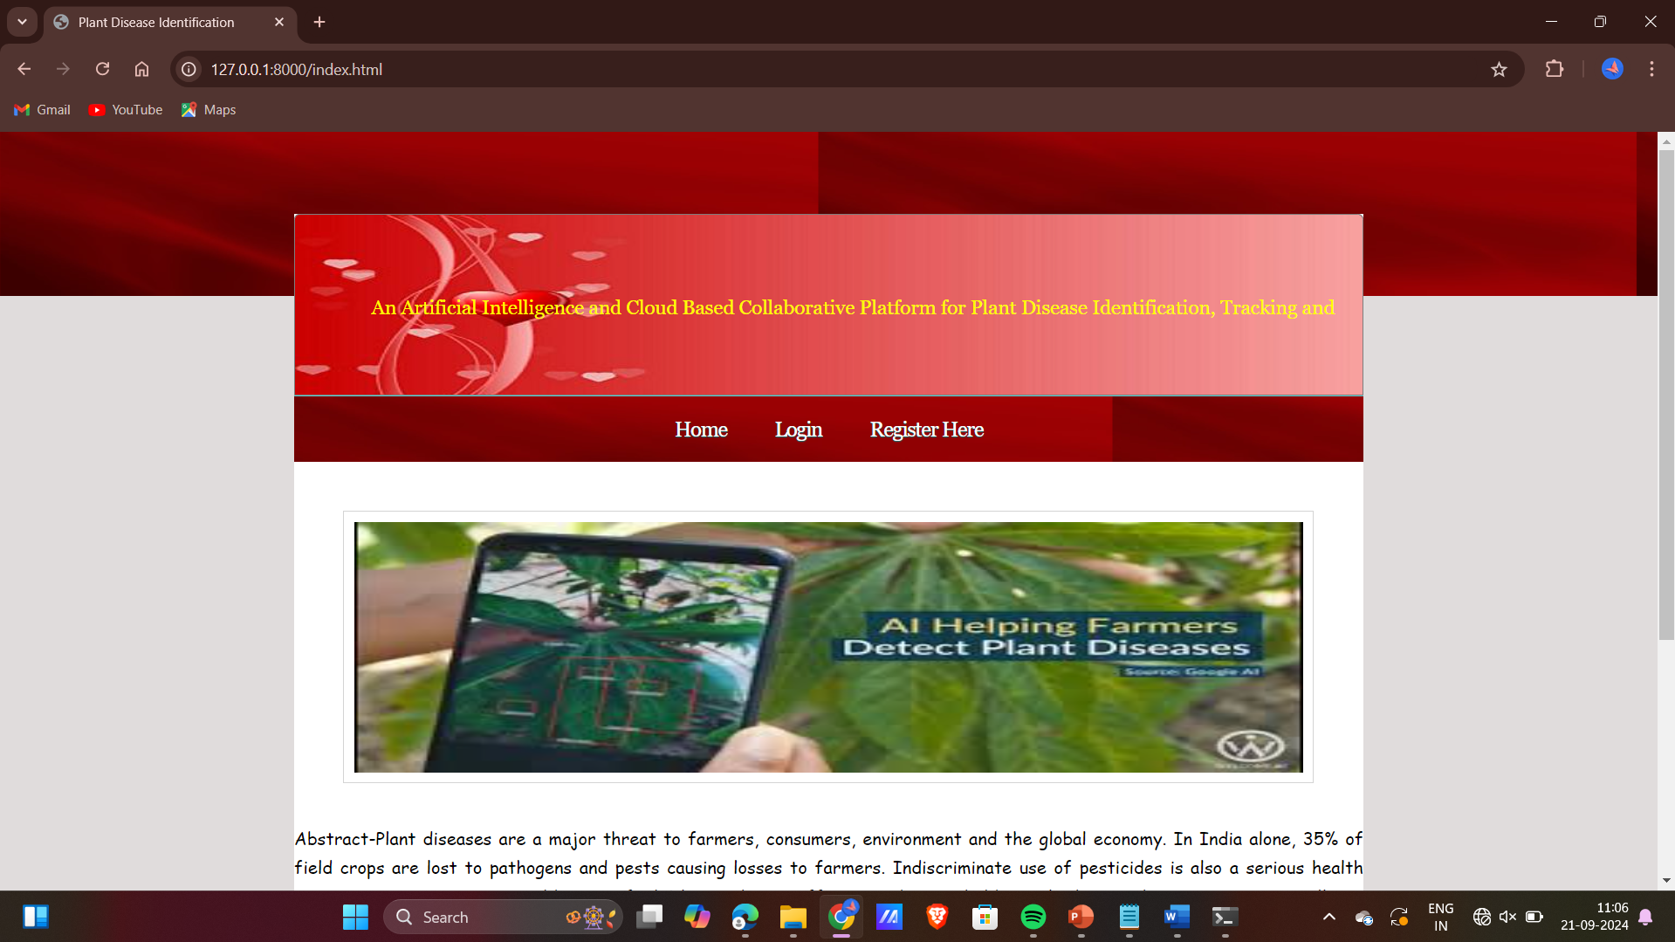
RESULT
Index.html

Slide 20
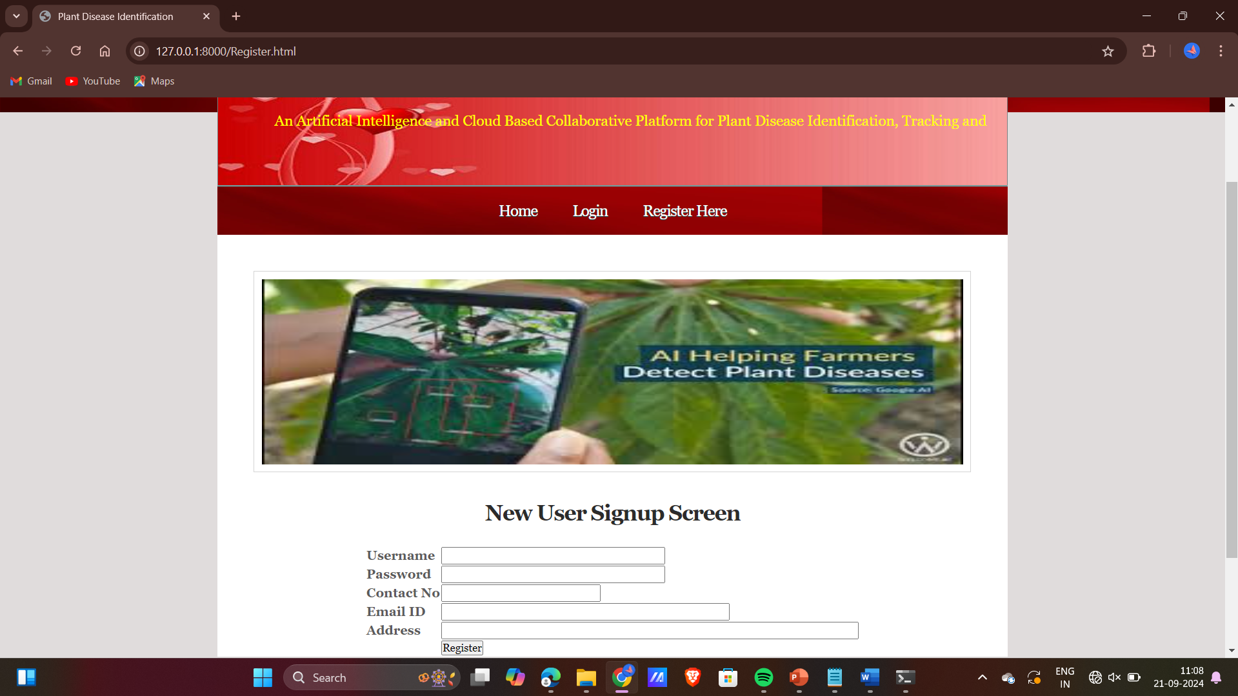
Register.html

Slide 21
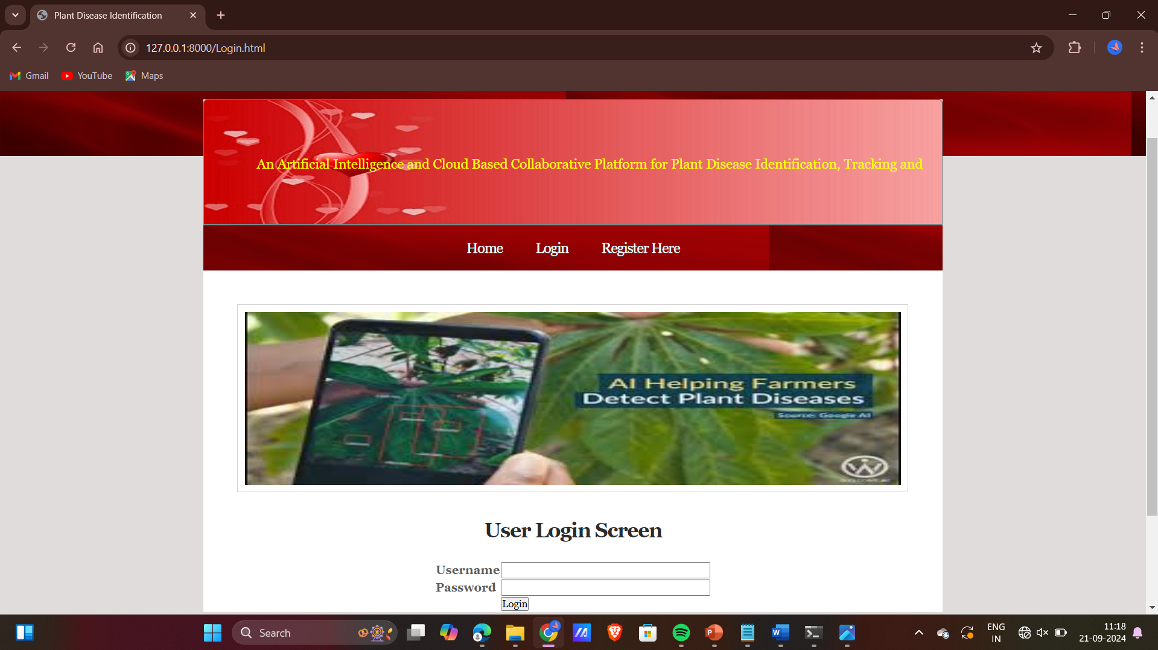
Login.html

Slide 22
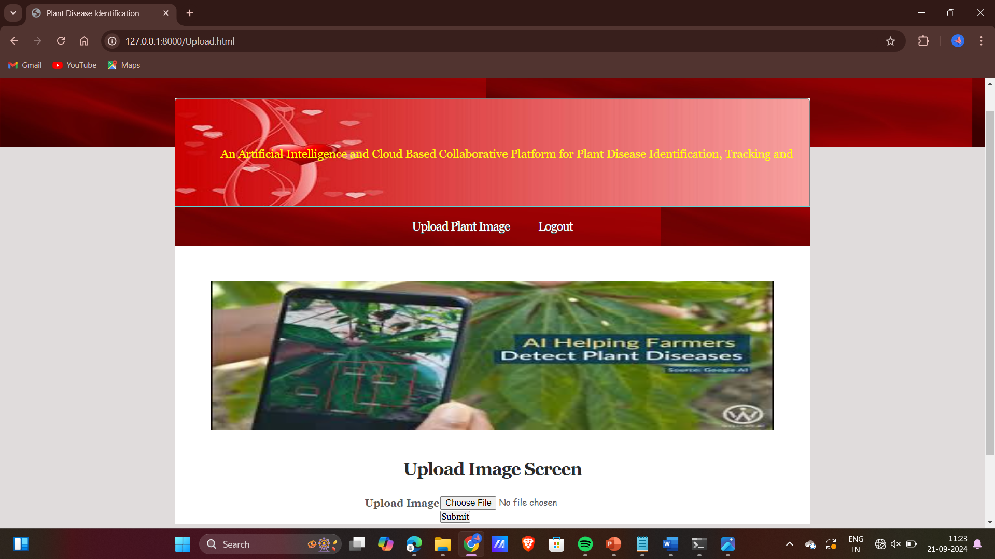
Upload.html

Slide 23
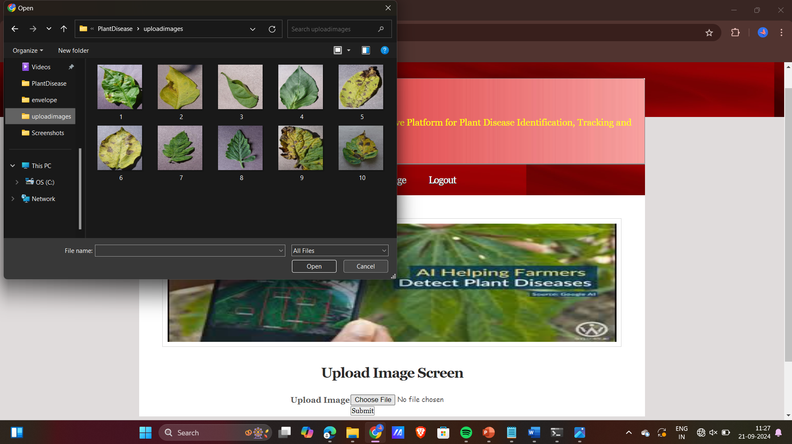

Slide 24
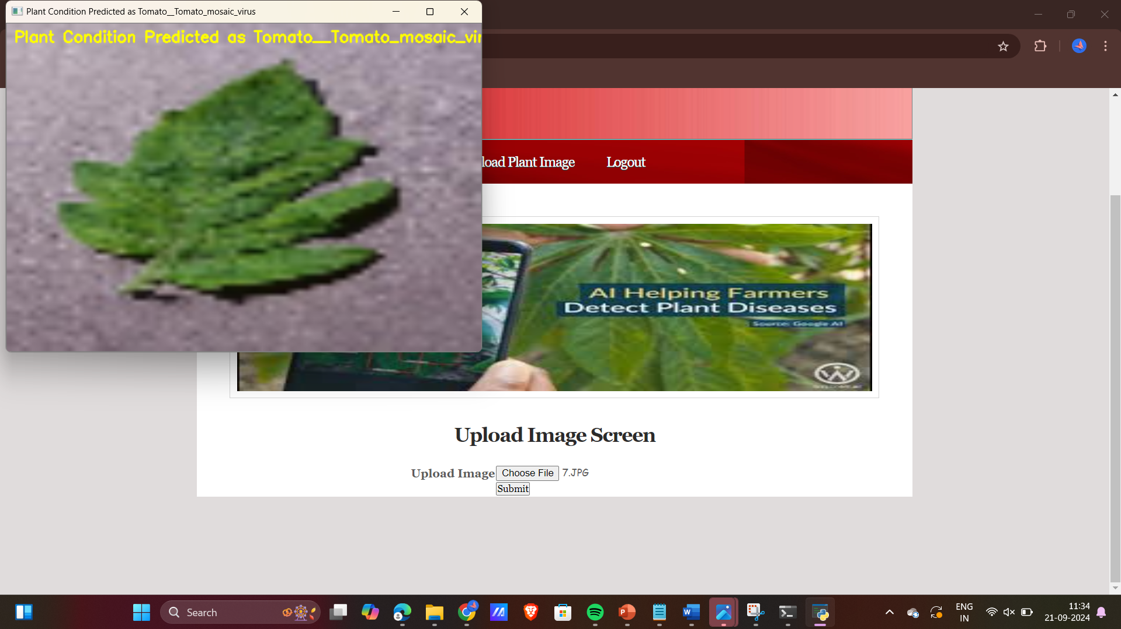

Slide 25
CONCLUSION
Our project proposes an innovative, automated, and user-friendly solution to address the need for early and accurate crop disease detection, helping farmers make timely decisions for disease management.
The CNN model is used in a web app to classify diseases in real-time. User-submitted images contribute to retraining the model, improving accuracy.
The system can detect early disease symptoms, differentiate between related diseases, and continuously improve as the dataset grows, demonstrating strong performance for handling a large number of disease classes.

Slide 26
FUTURE SCOPE
In order to strengthen the connection to the pollution, future research should expand the model to include more variables. We may supplement the picture collection with farmer inputs about soil, and publicly available environmental factors like temperature, humidity, and rainfall to improve our model's accuracy and enable disease predictions.
We also want to decrease the frequency of expert engagement and broaden the spectrum of agricultural disorders that may be managed, excluding newly discovered diseases. More accurate class predictions with less human intervention will result from the ability to automatically normalize user-uploaded photos into the Training Database.

Slide 27
REFERENCES
[1] L. Saxena and L. Armstrong, "A survey of image processing techniques for agriculture," in Proceedings of Asian Federation for Information Technology in Agriculture, 2014, pp. 401-413.
[2] E. L. Stewart and B. A. McDonald, "Measuring quantitative virulence in the wheat pathogen Zymoseptoria tritici using high-throughput automated image analysis," in Phytopathology 104 9, 2014, pp. 985-992.
[3] A. Krizhevsky, I. Sutskever and G. E. Hinton, "Imagenet classification with deep convolutional neural networks," in Advances in Neural Information Processing Systems, 2012.
[4] TensorFlow. [Online]. Available: https://www.tensorflow.org/
[5] D. P. Hughes and and M. Salathé, "An open access repository of images on plant health to enable the development of mobile disease diagnostics through machine learning and crowdsourcing," in CoRR abs/1511.08060, 2015.

Slide 28
Github Link
https://github.com/sindhuvurugonda568/Plant-leaf-Disease-Prediction.git

Slide 29
THANK YOU

